Slide 1
WORK HUB-Multi-Tenant Enterprise Management Platform

Slide 2
DFD

Slide 3
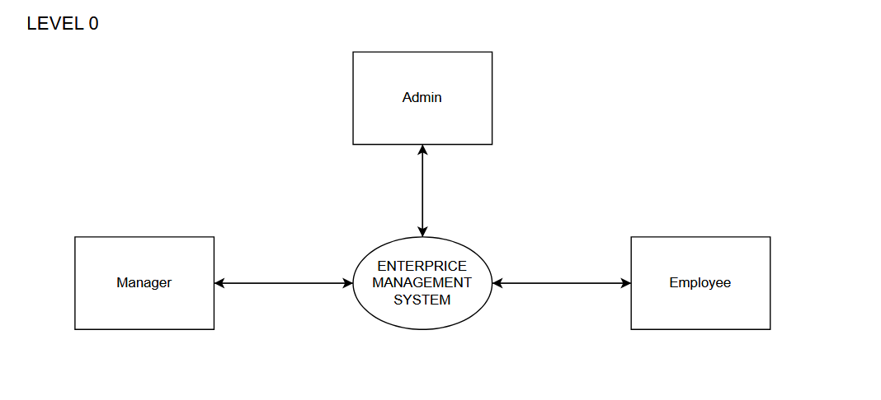

Slide 4
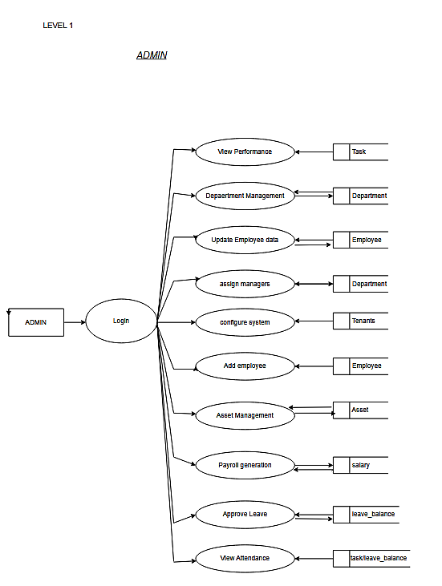

Slide 5
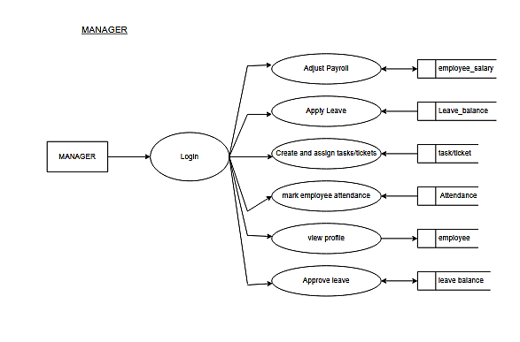

Slide 6
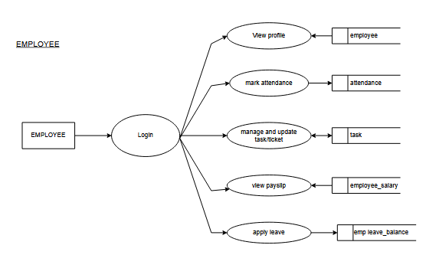

Slide 7
TABLES

Slide 8
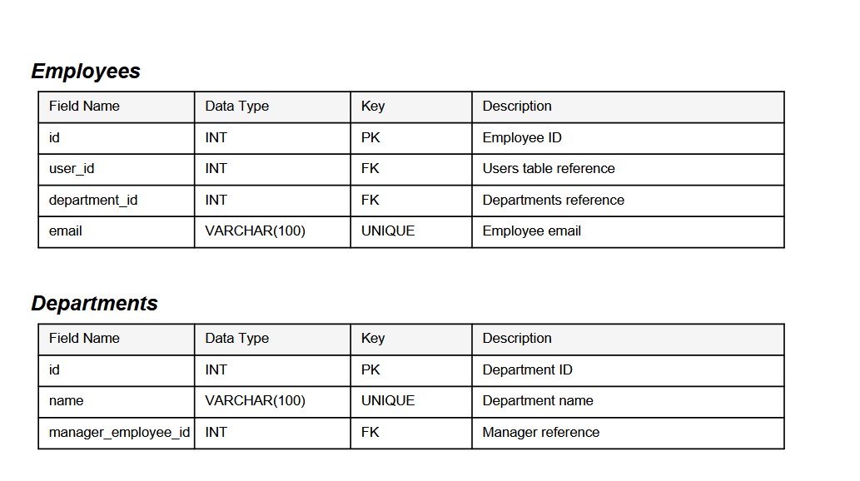

Slide 9
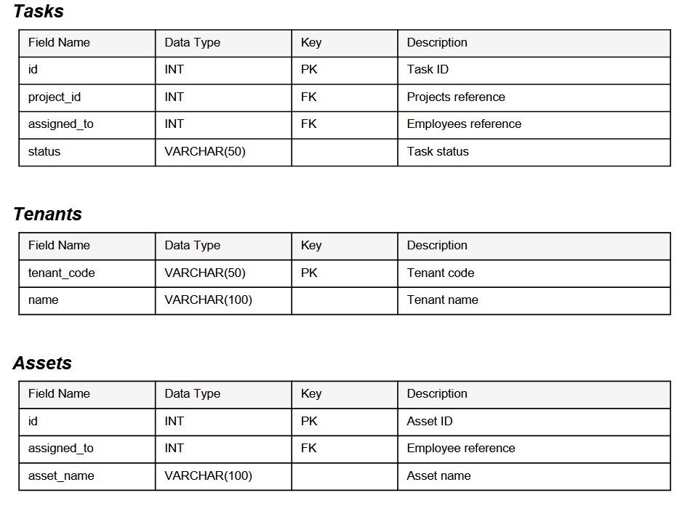

Slide 10
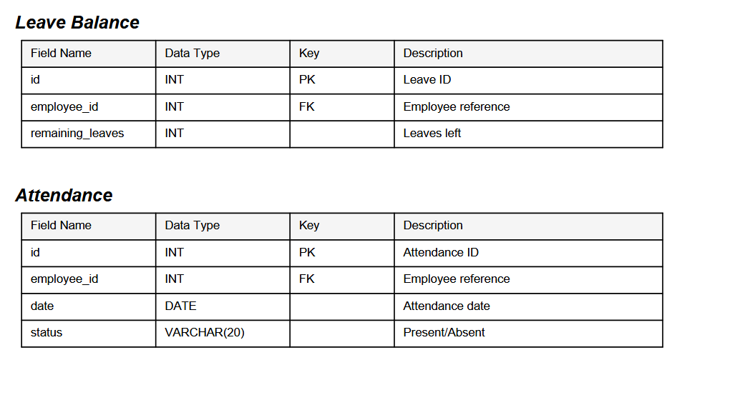

Slide 11


Slide 12


